Slide 1

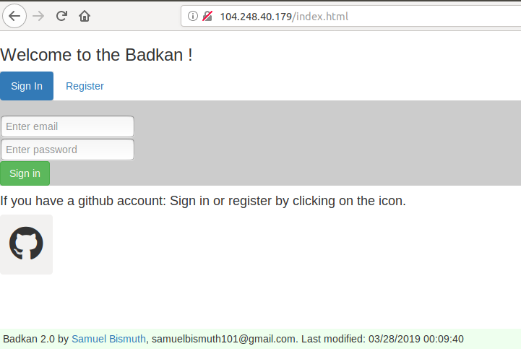
Badkan
The new solution for exercises submission.

Slide 2
Outline
The Problem
Solution Proposal
Next Steps

Slide 3
The Problem

Slide 4
Problem statement
What if practicing was a hobby?
Both part (instructor and students), are going to save time and will have a lot of fun.

Slide 5
What customers do today
Badkan is before everything a submission platform.
The difference comes with the automated checking, the flexibility and the gain of time of the platform.
The gamified environment is the bonus of the website.

Slide 6
Use cases
Each user has is own account with personal information. (Like grades…).
Each instructor can upload exercises on the platform (easy to use).
Each student can solve exercises and is graded in real-time.
Gamified environment: two solutions: 1 VS 1 or “escape room”.
The platform contains several exercises and templates ready to be used.

Slide 7
Solution Proposal

Slide 8
Solution description
Badkan is already used by more than 150 satisfied students.
It’s allow the students to submit efficiency all their assignments.
The instructor save a lot of time and can allied fun and practice by using the platform.

Slide 9
Why it’s better than existing solutions
Most of the existing “exercise submission” platforms have the next problems that the badkan attempts to fix:
No possibility to submit an entire project but only a single file.
No possibility to use version control (like GitHub) efficiently.
No gamified environment to have fun while practicing.
No possibility to see the exercise correction in real-time.
No possibility to share exercises with other instructors.

Slide 10
Next Steps

Slide 11
What next?
Continuous testing made by students.
Insertion of the new features.
Special implication on the UX.

Slide 12
Questions?

Slide 13
References
http://104.248.40.179/
Badkan
Badkan3

